Slide 1

AI 芯片
— GPU 详解
GPU工作原理
ZOMI

Slide 2
Talk Overview
AI 计算体系
  深度学习计算模式
  计算体系与矩阵运算
AI 芯片基础
  通用处理器 CPU
  从数据看 CPU 计算
  通用图形处理器 GPU
  AI专用处理器 NPU/TPU
  计算体系架构的黄金10年
硬件基础
  GPU 工作原理
  GPU AI编程本质
英伟达 GPU 架构
  从 Fermi 到 Hopper 架构
  Tensor Code 和 NVLink 详解
GPU 图形处理流水线
  图形流水线基础
  GPU 逻辑模块划分
  图形处理算法到硬件

Slide 3
Talk Overview
硬件基础
  GPU 工作原理
  GPU AI编程本质
英伟达 GPU 架构
  GPU基础概念
  从 Fermi 到 Volta 架构
  Turing 到 Hopper 架构
  Tensor Code 和 NVLink 详解
GPU 图形处理
  GPU 逻辑模块划分
  算法到 GPU 硬件
  GPU 的软件栈
  图形流水线基础
  流水线不可编译单元
  光线跟踪流水线

Slide 4
Talk Overview
GPU 工作原理
  AX+Y DEMO – AX+Y 例子
  What is inference system – 并发与并行
  Optimization objectives and constraints – GPU 缓存机制
  Difference bet inference system and engine – GPU线程原理

Slide 5

What is GPU & what make it diff
What is GPU：
GPU (Graphics Processing Units, GPUs) 原是设计用于处理图像视频等数据。
What Make GPU Diff CPU：
真正让GPU与CPU不同的是，GPU设计目标是最大化吞吐量 (Throughout)，比单任务执行快慢，更关心并行度 (parallelism)，即同时可以执行多少任务；CPU则更关心延迟 (latency) 和并发 (concurrency)。

Slide 6
AX+Y DEMO
看GPU工作原理

Slide 7
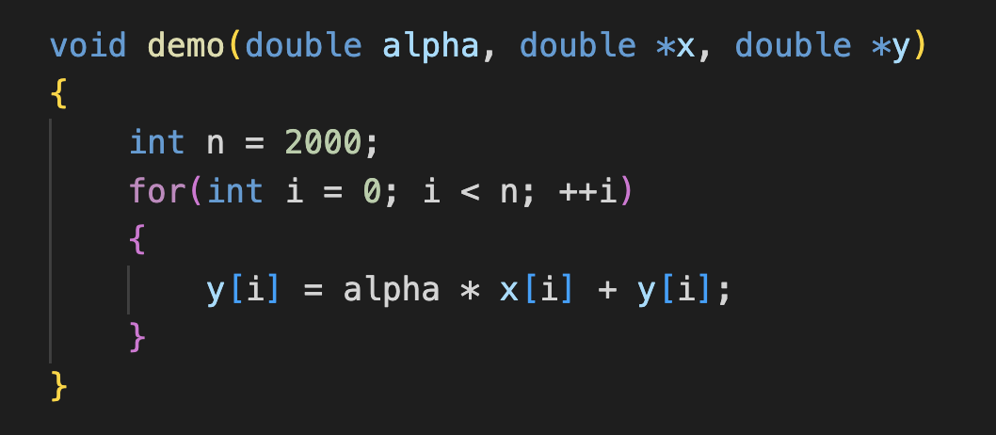
AX+Y 计算 DEMO
2FLOPs：multiply & add
2 Memory Loads: x[i] & y[i] (per element)
Single Operation: FMA(fused multiply-add)

Slide 8
AX+Y 计算 DEMO
Intel Exon 8280
Memory Bandwidth: 131 GB/sec
Memory latency: 89 ns
11,659 bytes can be moved in 89 ns
AXY demo move 16 byes per 89 ns latency
Memory efficiency = 0.14%

Slide 9
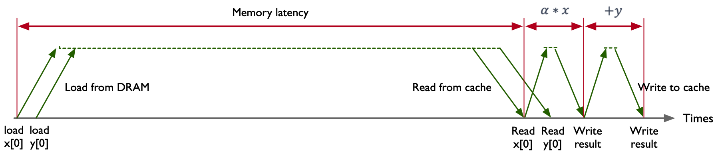
AX+Y 计算 DEMO
memory bus is idle 99.86% of the time

Slide 10
AX+Y 内存利用率
 | AMD Rome 7742 | Intel Xeon 8280 | NVIDIA A100
Memory B/W(GB/sec) | 204 | 131 | 1555
DRAM Latency(ns) | 122 | 89 | 404
Peak bytes per latency | 24,888 | 11,659 | 628,220
Memory Efficiency | 0.064% | 0.14% | 0.0025%

Slide 11
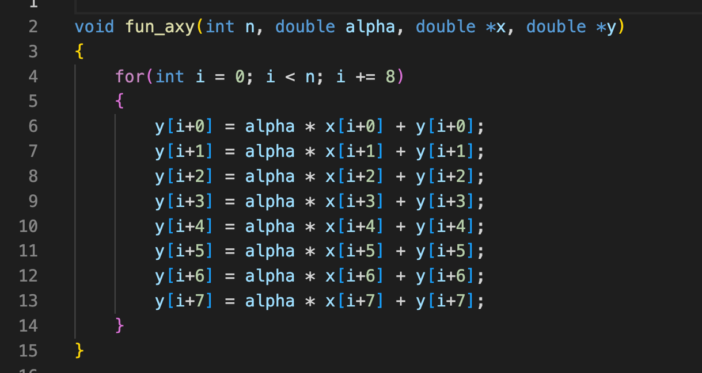
Z=AX+Y 通过并发进行循环展开
Keep Memory bus busy, run 11,659/16=729 iterations at once.

Slide 12

Z=AX+Y 通过并发进行循环展开
编译器很少对循环展开上100+
一个线程一次执行上千条指令
一个线程很难直接处理700个计算负载
Keep Memory bus busy, run 11,659/16=729 iterations at once.

Slide 13
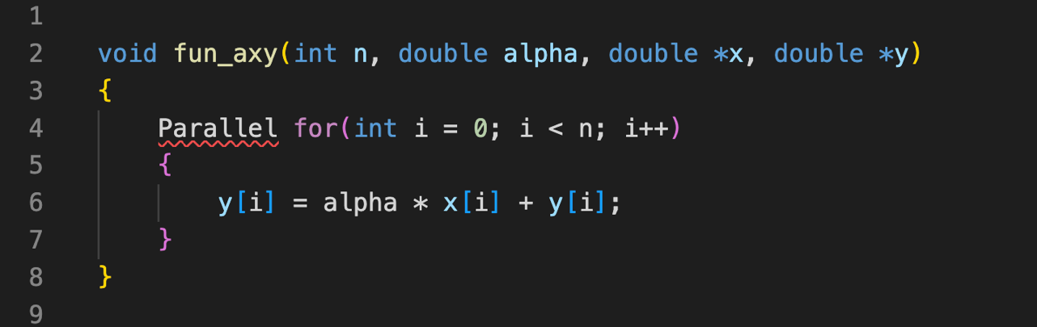
Z=AX+Y 通过并行进行循环展开
Keep Memory bus busy, run 11,659/16=729 iterations at once.

Slide 14
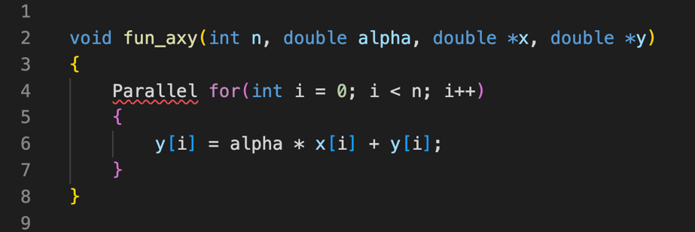
Z=AX+Y 通过并行进行循环展开
每个线程独立负责相关计算
一共需要 729 个线程
程序会受到线程数和内存请求 Bound
Keep Memory bus busy, run 11,659/16=729 iterations at once.

Slide 15
并行 Parallelism
并发 Concurrency

Slide 16
AX+Y 硬件架构线程区别
 | AMD Rome 7742 | Intel Xeon 8280 | NVIDIA A100
Memory B/W(GB/sec) | 204 | 143 | 1555
DRAM Latency(ns) | 122 | 89 | 404
Peak bytes per latency | 24,888 | 12,727 | 628,220
Memory Efficiency | 0.064% | 0.13% | 0.0025%
Threads required | 1,556 | 729 | 39,264
Threads available | 2048 | 896 | 221,184
Thread Ration | 1.3X | 1.2X | 5.6X

Slide 17
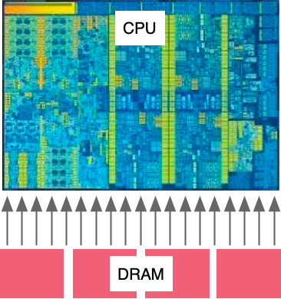
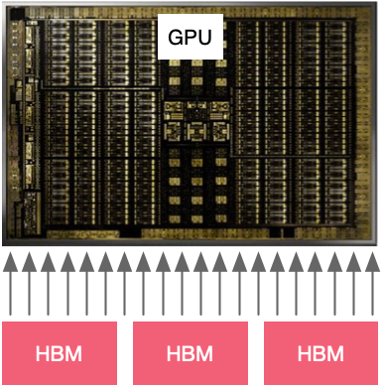
架构线程工作原理
 | AMD Rome 7742 | Intel Xeon 8280 | NVIDIA A100
Threads required | 1,556 | 729 | 39,264
Threads available | 2048 | 896 | 221,184
Thread Ration | 1.3X | 1.2X | 5.6X

Slide 18
GPU Cache
缓存机制

Slide 19
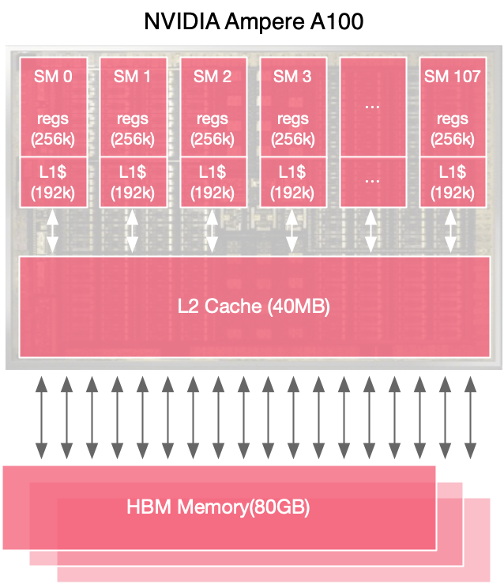
GPU 缓存机制
108 Streaming Multiprocessors(SMs)
256kB Register File per SM(27MB Total)
192kB L1 Cache & Shared Mem Per SM(20MB Total)
40MB L2 Cache Shared across all SMs
Caches 缓存
80GB High Bandwidth Memory

Slide 20
GPU 缓存机制
B/W
Latency
Off-Chip
B/W
Latency
13x
1x
0.02x
25x
3x
5x
PCIe
1x
15x

Slide 21
GPU 缓存机制
B/W
Latency
Data Location | Bandwidth (GB/sec) | Compute Intensity
L1 Cache | 19,400 | 8
L2 Cache | 4,000 | 39
HBM | 1,555 | 100
NVLink | 300 | 520
PCIe | 25 | 6240
13x
1x
3x
5x
1x
15x

Slide 22
GPU 缓存机制
B/W
Latency
Data Location | Latency (ns) | Threads Required
L1 Cache | 27 | 32,738
L2 Cache | 150 | 37,500
HBM | 404 | 39,264
NVLink | 700 | 13,125
PCIe | 1470 | 2297
13x
1x
3x
5x
1x
15x

Slide 23
GPU Thread
线程原理

Slide 24
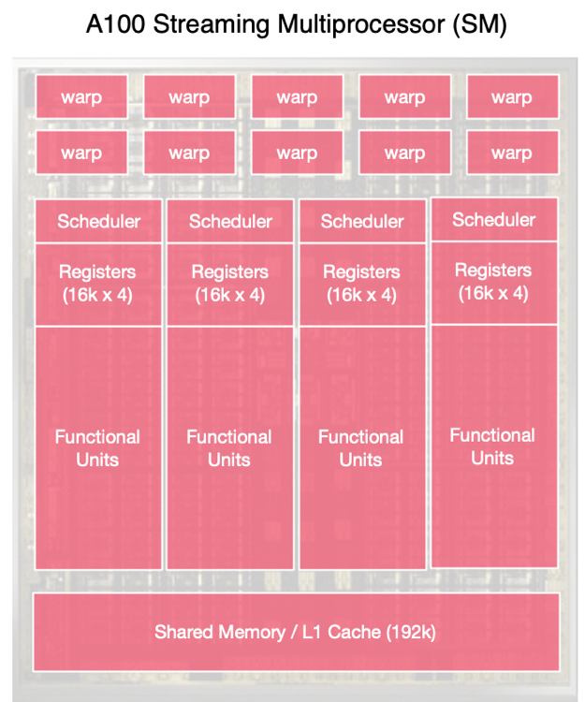
GPU 线程机制
64 warps/SM
4x concurrent warp exec
64k 4-byte registers
192KB L1/shared memory
(configurable split)
GPU runs threads in groups of 32 – each group is known as a warp

Slide 25
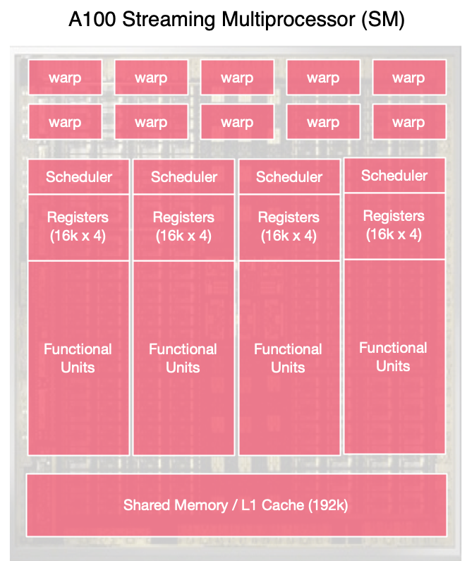
GPU SMs 线程超配
 | Pre SM | A100
Total Threads | 2048 | 221,184
Total Warps | 64 | 6,912
Active Warps | 4 | 432
Waiting Warps | 60 | 6,480
Active Threads | 128 | 13,824
Waiting Threads | 1,920 | 207,360
64 warps/SM
4x concurrent warp exec
64k 4-byte registers
192KB L1/shared memory
(configurable split)

Slide 26
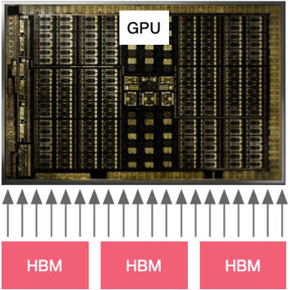

CPU/GPU 并行才是本质
Time

Slide 27
CPU/GPU 并行才是本质
Time

Slide 28
Reference
https://www.techtarget.com/searchvirtualdesktop/definition/GPU-graphics-processing-unit
https://www.techtarget.com/searchvirtualdesktop/definition/GPU-graphics-processing-unit#:~:text=GPUs%20work%20by%20using%20a,%2C%20high%2Dquality%20graphics%20rendering.
https://computer.howstuffworks.com/graphics-card.htm
https://www.cs.cmu.edu/afs/cs/academic/class/15462-f11/www/lec_slides/lec19.pdf
https://www.intel.com/content/www/us/en/products/docs/processors/what-is-a-gpu.html
https://www.investopedia.com/terms/g/graphics-processing-unit-gpu.asp
https://www.youtube.com/watch?v=0_TN845dxUU
https://www.youtube.com/watch?v=nEMzIwzmJT8
https://www.heavy.ai/technical-glossary/cpu-vs-gpu
https://www.youtube.com/watch?v=3l10o0DYJXg
https://www.youtube.com/watch?v=658n_Ym8dkk
https://www.youtube.com/watch?v=5BiAlaFGCoE
https://www.youtube.com/watch?v=bZdxcHEM-uc

Slide 29
Notes:
29

